Slide 1

Government Polytechnic, Khamgaon
Pocket GPK : An Android Application
TEAM MEMBERS: GUIDED BY:
Mohit R. Peshwnai Prof. M. M. Andhare
Pavan S. Patil
Shaikh Ajmal
Rutik B. Gawai
Vishal A. Ingle
Notes:
1

Slide 2
CONTENTS
INTRODUCTION
REQUIREMENTS
OVERALL DESIGN
USE CASES
BENEFITS
FUTURE PLAN
CONCLUSION
Thank you

Slide 3
INTRODUCTION
An application that contains following features: Provide notice to students also interact college website through app , also get important notes through “Pocket GPK’’.
This is the smart way to get notice from everywhere through this Application.
The purpose of “pocket Gpk An Android application” is to automated the college system using online services and make one step ahead to digitalized the college management through the android smartphone which is available everywhere and easy handled .

Slide 4

REQUIREMENT
User Interfaces:
1.add document(Admin/Teachers)
2.Only Viewed(Students)
Project Requirement:
Software Requirement: Android Studio 2.3.1 or above
Hardware Requirement: Android Smartphone.
Operating System: Android
Database : Firebase
Upload the survey and notice through blogger and polleverywhere

Slide 5
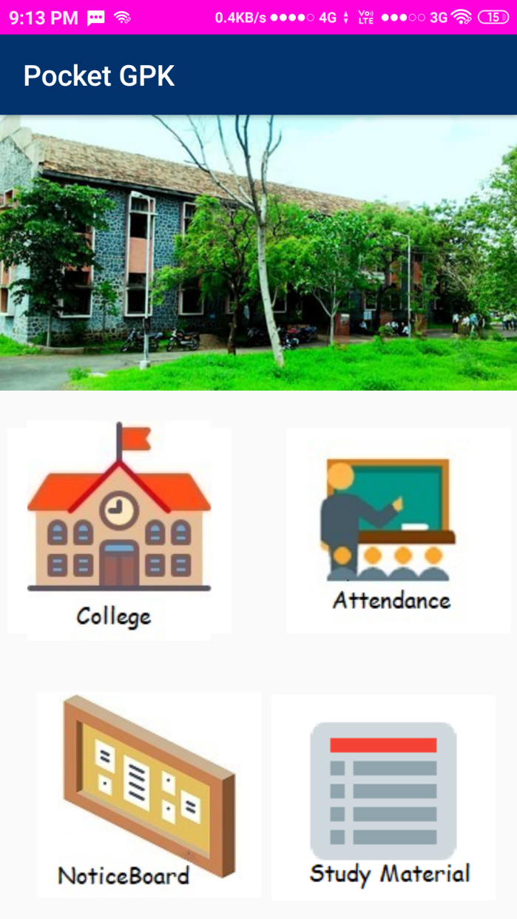
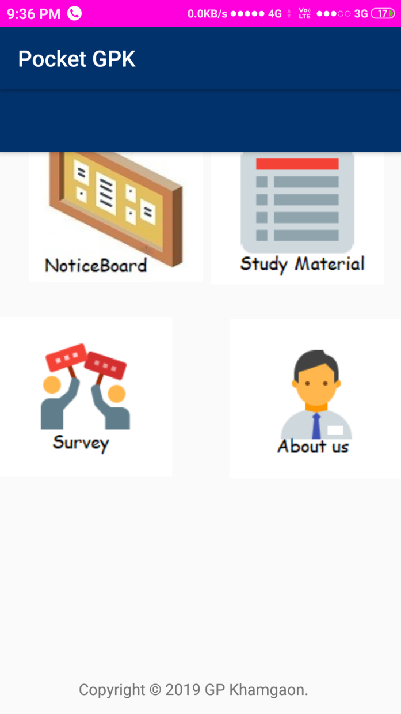
OVERALL DESIGN

Slide 6
OVERALL DESIGN
Function of each module are follow:
For Interact with College Website
For take attendance ,manage attendance and View the status of Attendance
Get the Attendance of the College
and Up-todate with Events and other major curriculum and non-curriulum activites
Study The material for find the PPTs,PDfs, Documentation file(.doc ), Tabular files (.xls) and previous years question papers get dfownloaded.
This ismainly to get or understand your mentality/intreset through the surveys taken by Admin and Teachers.
This is the activity that's define how is creator the ap[plication under guidance of Prof A.M. Andhare sir

Slide 7
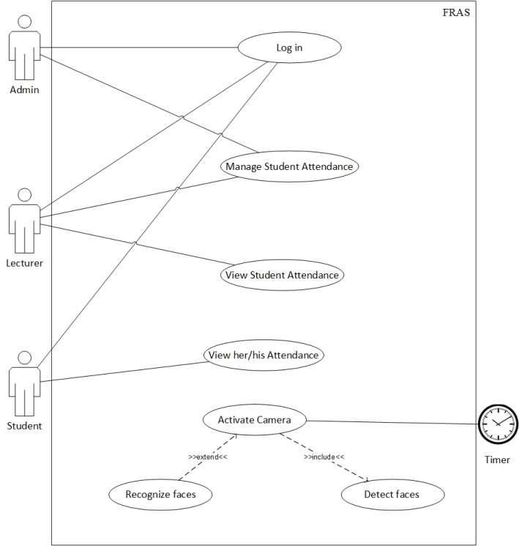
USE CASE DIAGRAM FOR EATTENDANCE

Slide 8
USE CASE DIAGRAM FOR ADMIN

Slide 9
USE CASE DIAGRAM FOR TEACHER
Login for AttendanceStuentAdmin Acivitr PDFs, Documell lls through tyhe android application through the PPTs, PDFs, Documernt files()with curriculum
View College Cell
Upload notification
Teacher
Take Attendance
Take Survey of Students

Slide 10
USE CASE DIAGRAM FOR STUDENTS
Login for assuring
Attendance record
View Notification
View Notes and
other study material
Student
Take part in Survey

Slide 11
BENEFITS
Application is available on Android App.
Teacher can upload notice from anywhere.
As this’s online it’s available everywhere.

Slide 12
FUTURE PLAN
we add Question papers MCQs online instance Check.
Check coordination of students in curriculum and co-curriculum activities.
Online classes through the concept of video conferencing.
Online form fill-upper along with digital signature for verification uses SHA-1 Algorithm.

Slide 13
CONCLUSION
Diverse operating system.
Help environmental solution.
Not very time Consuming.
Efficient.
24*7 availability.
Smart Way
More efficient than website

Slide 14
Thank
For
Given
opportunity

